Slide 1

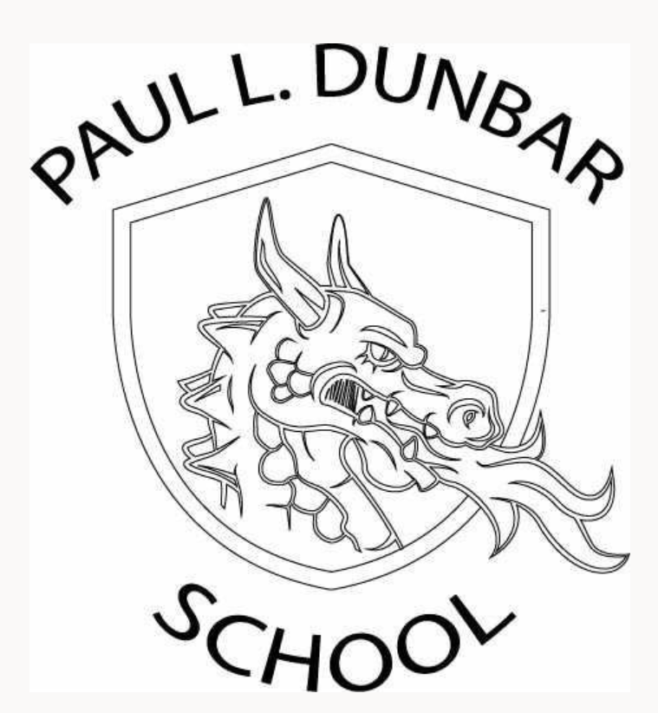
Transition to Hybrid Learning Orientation
March 9, 2021
We will begin shortly.
Please mute your microphone.

Slide 2

Welcome Back!
This is an informative session to highlight safety protocols and procedures expected for hybrid learning.
Please mute your microphones.
The meeting is being recorded for families who cannot attend, and a copy of this recording will be placed on our website.

Slide 3
Our Priorities
Maintaining the health, safety, and well-being of our scholars and staff
Exemplify excellence in learning and teaching, filled with joy and aligned to a coherent, unified core curriculum
Supporting our scholars, staff, and families as they adapt to new methods and rhythms of learning and teaching
Ensuring operational efficiency across the organization to encourage flexibility and financial health
Partnering with community organizations and leveraging local assets to more fully and equitably support our scholars and their families
To view more details about the health and safety protocols in place at every school visit our website at:
https://www.clevelandmetroschools.org/Hybrid
and well-being of our s
Notes:
Website will have updates to Guidebook, schedules, other important information. Page update notifications will posted.

Slide 4
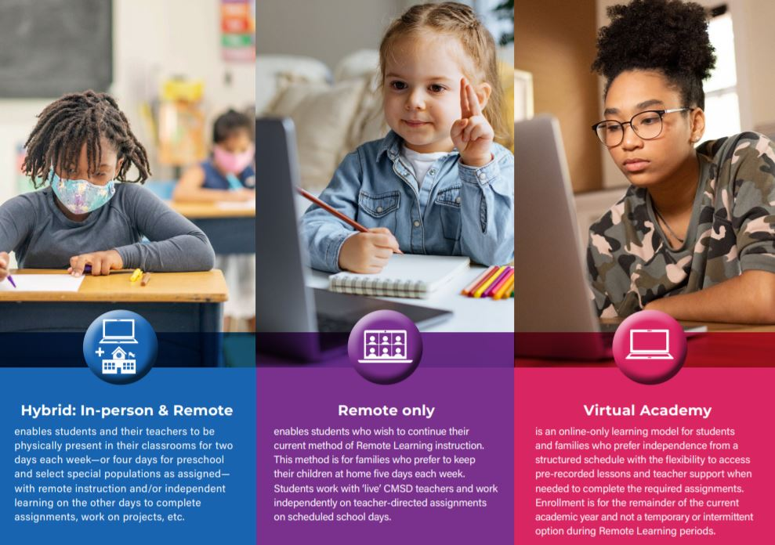
Notes:
Learning options for scholars and families. Visit webpage for more information on these models. https://www.clevelandmetroschools.org/Page/18504

Slide 5
OPT out Information
Families who want to remain in Remote Learning can do so by calling 216.838.3675 to speak with an enrollment specialist. Deadline to OPT out is March 19th.
You may also use the link on the district’s hybrid page.
https://app.smartsheet.com/b/form/19ee16ad3d12405dbb17fee28549f341
Notes:
Need to let parents know at what point (date) decision is binding.

Slide 6
Hybrid Learning Schedules
Students will be in school two or four days per week depending on their assignment
Most students will attend school two days per week
Only Preschool and special populations of students will attend four days per week
Students will be in Remote Learning or independent study on the other days
Parents may request to change their child’s assigned days by calling the Office of School Choice and Enrollment at 216.838.3675

Slide 7
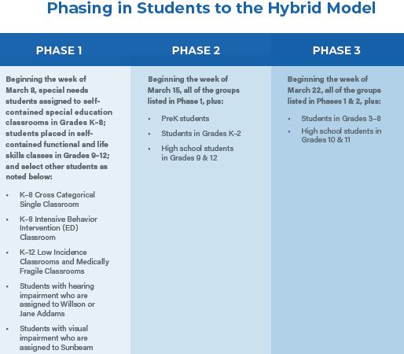
Friday, March 12th Mr. Boru, Ms.Stevens, Mr. Damron, Mrs. E. Mullins | Week of March 15th Grades PreK – 2 | Week of March 22nd Grades 3-8

Slide 8
Friday, March 12th Monday Tuesday Thursday Friday Mr. Boru, Ms. Stevens, Mr. Damron, Mrs. E. Mullins | Week of March 15th Grades Pre-K-2 Cohort A Monday Tuesday Cohort B Thursday Friday | Week of March 22nd Grades 3-8 Cohort A Monday Tuesday Cohort B Thursday Friday
Our school-wide hybrid schedule will begin March 12th from 9:35-4:05.
Scholars’ schedule will be re-posted on teachers Schoology Page prior to their hybrid transition.

Slide 9
Important Contacts
Courine Elias-Raffoul, Principal
courine.elias@clevelandmetroschools.org
Paul Dunbar Office: 216-838-7400
Linda Register, Secretary
Susan Brunecz, Instructional Coach
susan.brunecz@clevelandmetroschools.org
Marlyn Morales, Bilingual Aide
marlyn.morales@clevelandmetroschools.org
Susan Sopko, Special Ed. Liaison
susan.sopko@clevelandmetroschools.org

Slide 10
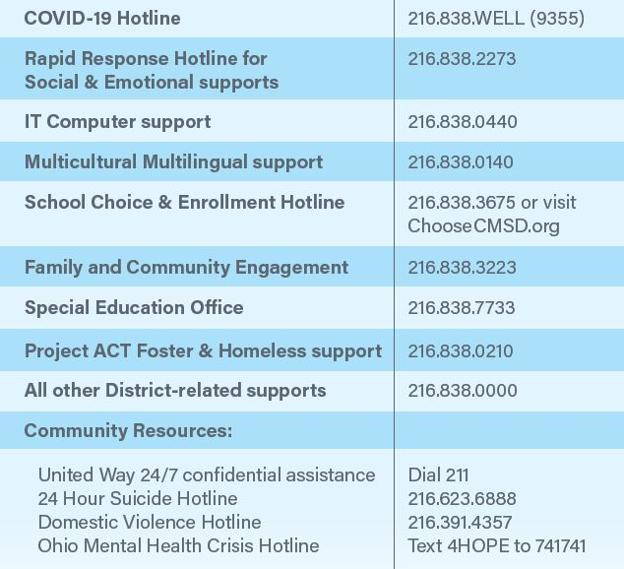
Other Important Numbers

Slide 11

Update Your
Contact Information
With students returning to the building, it is IMPORTANT that we have accurate contact information!
Please update your contact information if it has changed or we do not have the correct number or email address.
We need to be able to communicate with you!

Slide 12

School Hours and Visitation Procedures
School hours: 9:35 a.m. – 4:05 p.m.
Please call to make an appointment prior to visit.
Visitors will complete COVID-19 health screening and have their temperature checked prior to entering the building. Visitors should social distance (6 feet).
All visitors must wear a face mask. If you don’t have a mask, one will be provided.

Slide 13

For the Safety of Everyone
Parents/Guardians/Visitors/Volunteers are NOT allowed inside the building or classrooms during the school day, except for a scheduled appointment or meal pick up.
The goal is to keep everyone safe. We need everyone, staff, students, and families to work together to help keep the school safe.

Slide 14

Arrival
All scholars must enter through the main doors.
Buses will arrive between 9:15 – 9:20. Scholars will remain on bus until directed.
Car riders should stay in the car until directed.
Walkers will line up as directed.
Scholars must maintain a 6-foot distance when in line.
Temperatures will be taken before scholars enter.
Security will check bags as scholars walk through the metal detector.
We ask for your patience in this process as it will take longer than usual. In most cases, children will be eating breakfast in their classrooms during morning meeting time.
Notes:
Put arrival routine, safety protocols, temperature checks, etc.

Slide 15
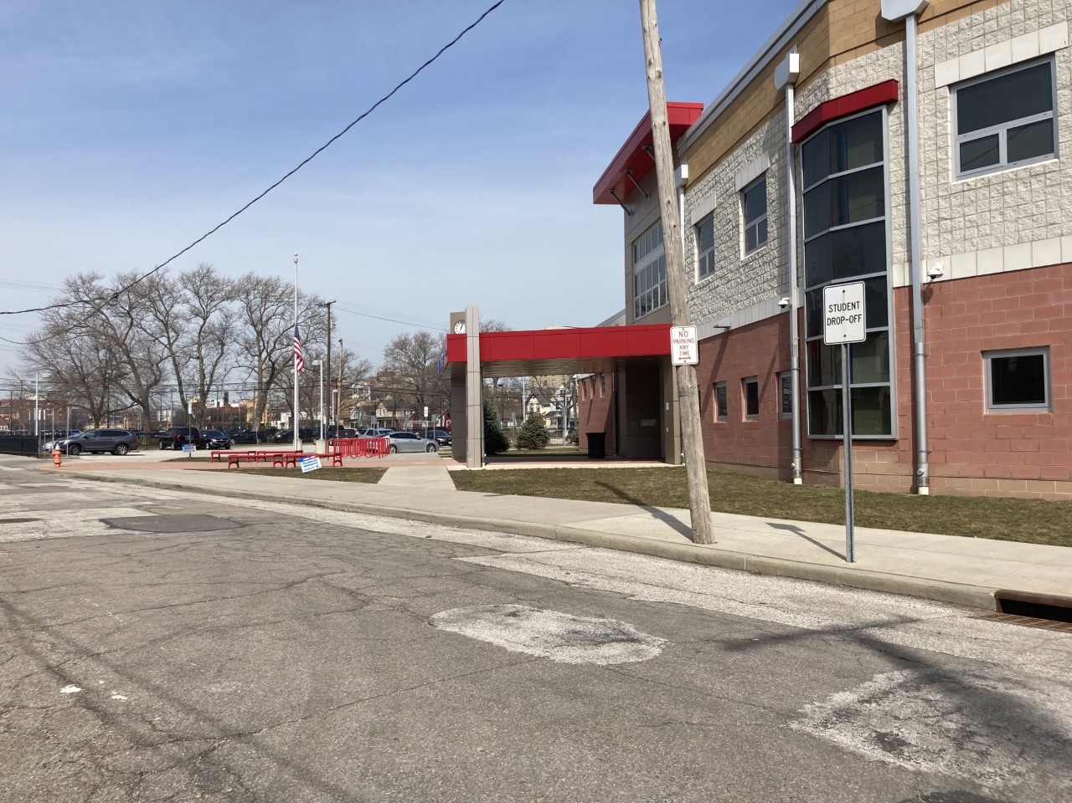

Dismissal
All scholars will exit through the main door.
Scholars will remain in the building until called to their assigned area or to exit the building.
Again, we ask for your patience in this process as it may take longer than usual.
Car riders –parents please park along the curb

Slide 16
Getting Ready for School
Parents/caregivers will check their student’s health at home each morning
Students should stay home if they have any of these symptoms:
Fever of 100.4°
Cough
Headache
New loss of taste or smell
Sore throat
Congestion or runny nose
Fatigue
Nausea or vomiting
Diarrhea
Muscle or body aches

Slide 17

Getting Ready for School
Students will wear their clean cloth face covering to school and wear it throughout the day. We will provide cloth facemasks for all students and face shields for prek, kindergarten and some special population students.
Additional facemasks will be provided for students who need them.
Students (grades 1st – 12th) will be provided a CMSD computer backpack and should bring their fully charged device every day.
Uniforms are NOT required; however, students must wear school appropriate clothing.

Slide 18

Healthy & Safety
CMSD continues to follow recommendations of medical and health experts
Temperature checkpoints and hand sanitizing stations are in place at all school buildings
Social distancing, defined as 6 feet between people, will be maintained at all times
Capacity on buses and in classrooms is limited to ensure fewer students are using the space at the same time
Classrooms, other areas of the school and buses will be cleaned and sanitized regularly between use

Slide 19
What Students Can Expect
High-quality instruction aligned to content, curriculum and method of delivery
One-to-one technology
Prepackaged meals to reduce food service lines.
Monitoring by a school nurse or health aide when exhibiting symptoms until picked up from school.
Access to a designated Care Clinic while waiting to be picked up.
Students should stay home for a full 24 hours after the fever or symptoms subside.
Access to a COVID-19 Hotline for any questions or concerns, 216.838.WELL (9355).

Slide 20
What Families Can Expect
Social distancing when their child is on a school bus, in a classroom, during breakfast, lunch, and other times in school facilities
Altered school and bus schedules due to decreased capacity
Required face coverings for students and parents in accordance with state and local guidance
  A limited number will be provided to each student
  Parents/caregivers/visitors will be provided masks as needed

Slide 21
What Families Can Expect
Two-way communication (phone calls, text messages, virtual meetings, and email)
Newsletter, updates via website and social media Paul L. Dunbar Arts Enrichment Academy Facebook
Virtual Family Engagement activities
Virtual or Phone Parent/teacher conferences
Access to a COVID-19 Hotline for any questions or concerns, 216.838.WELL (9355)

Slide 22
School Supplies and Materials
Paul L. Dunbar will be providing students with the basic school supplies they will need for in-person learning. Each scholar will be given their own personal supply pouch which will remain at school for their use only.

Slide 23
Supporting Your Scholar’s Hybrid Learning
Get back into the routine of going back to school in-person, i.e. making bed, grooming, dressing for school, etc.
School uniforms are NOT required, but scholars should wear school appropriate clothing during hybrid and remote learning.
Create a schedule with your child and make a commitment to stick with it.
Structure and routine can greatly help your child from falling behind with assignments.
Discuss your family’s schedule and identify the best times for learning and instruction, as well as family-oriented physical activity, such as walks outside.
Use a family calendar or other visuals to keep track of in-person and remote days, deadlines and assignments.

Slide 24
Supporting Your Scholar’s Social Emotional Wellness
Watch for behavior changes in your child (e.g., excessive crying or irritation, excessive worry or sadness, unhealthy eating or sleeping habits, difficulty concentrating), which may be signs of your child struggling with stress and anxiety.
Ask how your child is feeling and communicate that what they may be feeling is normal.
Identify opportunities for your child to be physically active during hybrid/virtual/at-home learning.
Reach out to school staff.
Applewood Counselor-Ms. Megan
Full time School Nurse- Nurse Tamika

Slide 25
Meal Distribution
Paul Dunbar will continue to distribute Grab ‘N Go meals for scholar’s remote days and for families who choose remote only. Parents/caregivers will enter through the main door, go through health and safety protocol, and wait in the front office to receive their meals.

Slide 26
Transportation
School Transportation Policies During COVID-19 Pandemic
Student Transportation Eligibility In order to comply with recommended safety precautions during the COVID-19 pandemic, the CMSD Board of Education temporarily amended its transportation policy to limit the number of students that can safely board and travel on school buses during Hybrid Learning.
Temporarily, during the pandemic, students who live less than two miles from their school are not eligible for transportation on a yellow bus. Students assigned to ride RTA will receive one (1) two-ride bus ticket per day from their school.
After the pandemic, CMSD will return to our normal transportation policy that enables significantly more students to qualify for yellow bus transportation.
Read more information for Transportation Guidelines during the COVID-19 Pandemic.

Slide 27
Transportation - RTA
Students assigned to ride RTA will receive one (1) two-ride bus ticket per day from their school.
RTA bus passes will be distributed to eligible 7th and 8th grade students during lunch each day.
The ticket will get them home and then back to school the next day they attend.

Slide 28

Thank you for attending!
Please do not hesitate to contact the school with any questions or concerns.

